Slide 1
Excel Final Assessment - Batch -4
Name : Prabu T
Emp ID: 4295

Slide 2
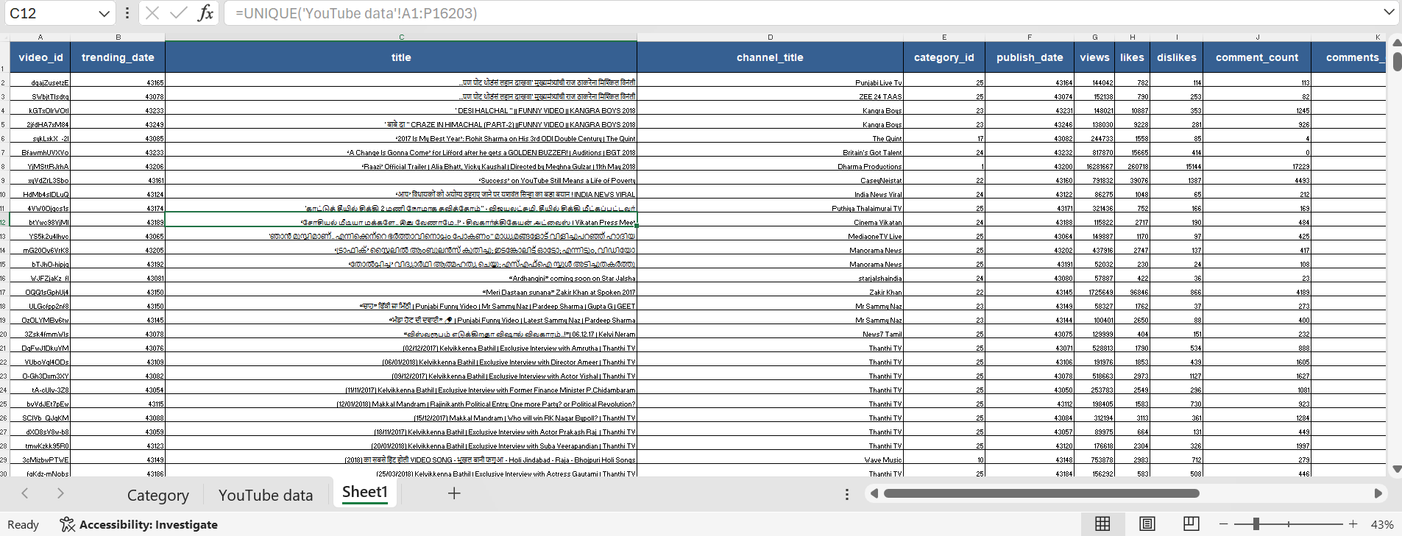
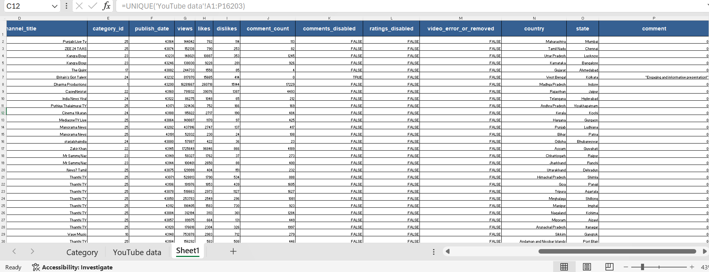
Task 1
Inference :
Steps :

Slide 3
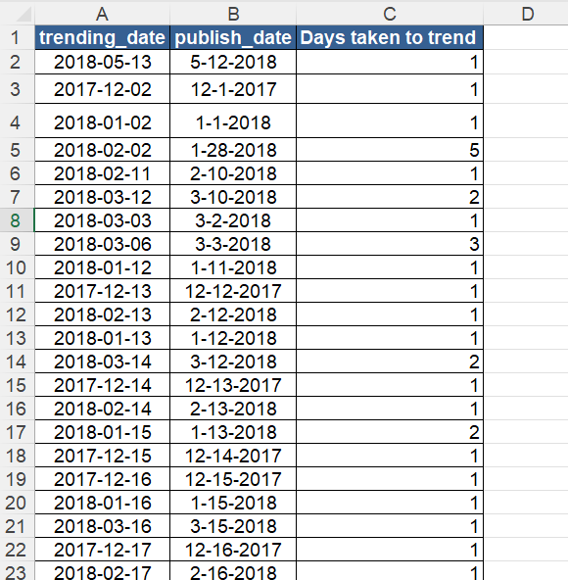
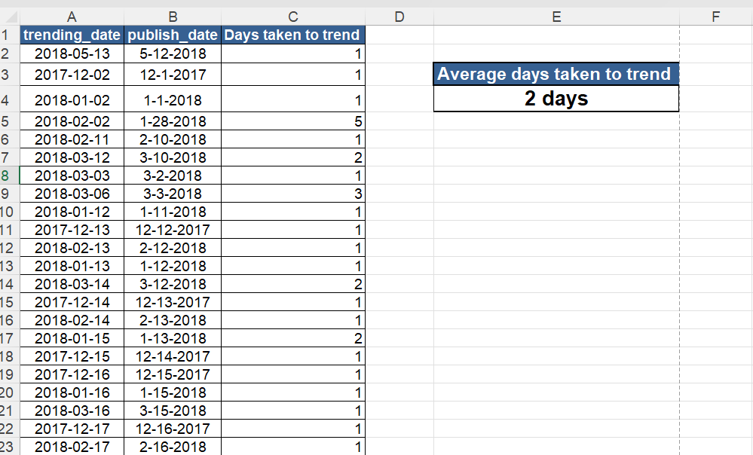
Task 2
Inference :
Steps :

Slide 4
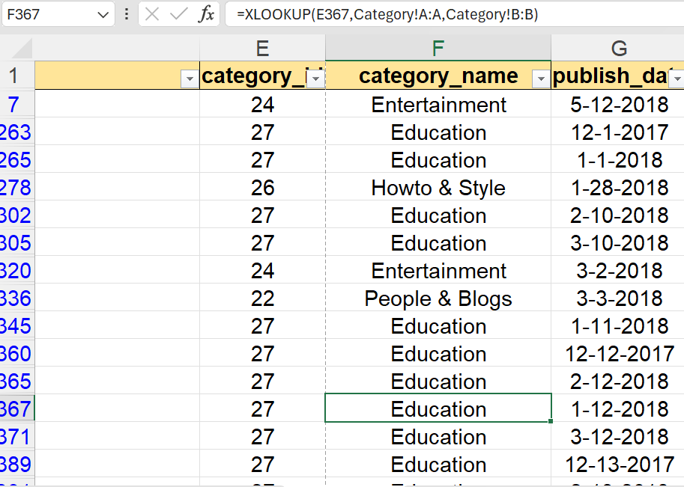
Task 3
Inference :
Steps :

Slide 5
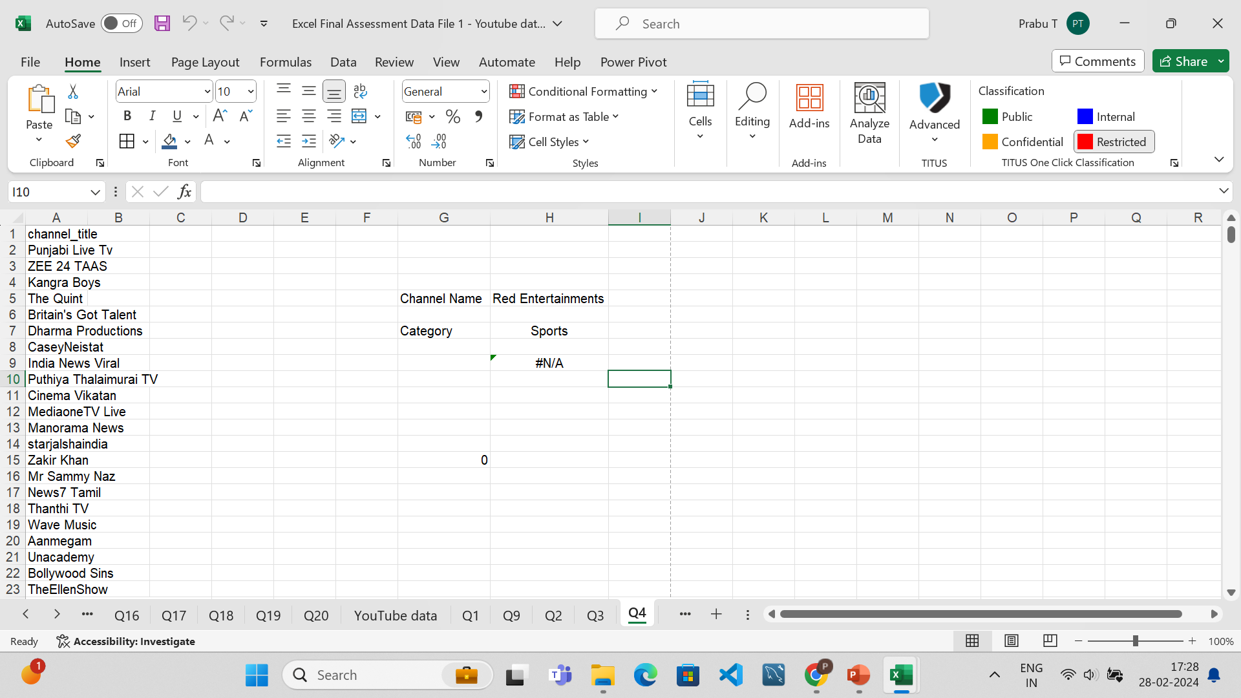
Task 4
Inference :
Steps :

Slide 6
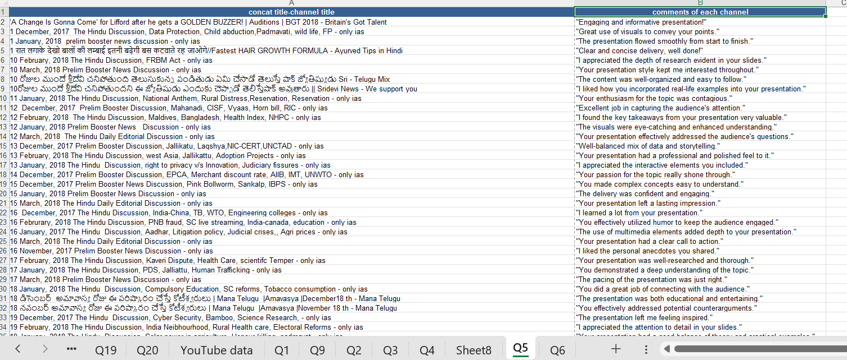
Task 5
Inference :
Steps :

Slide 7
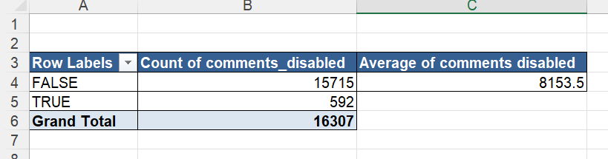
Task 6
Inference :
Steps :

Slide 8
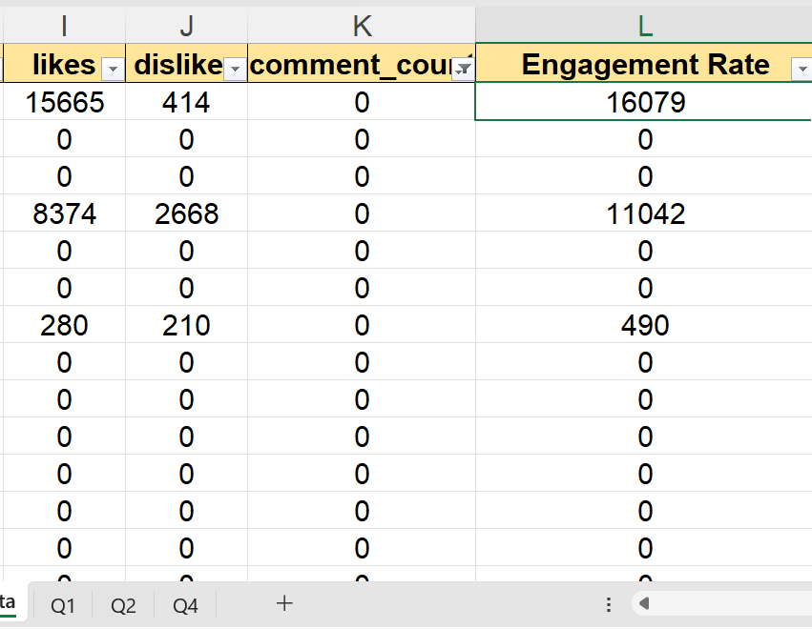
Task 7
Inference :
Steps :

Slide 9
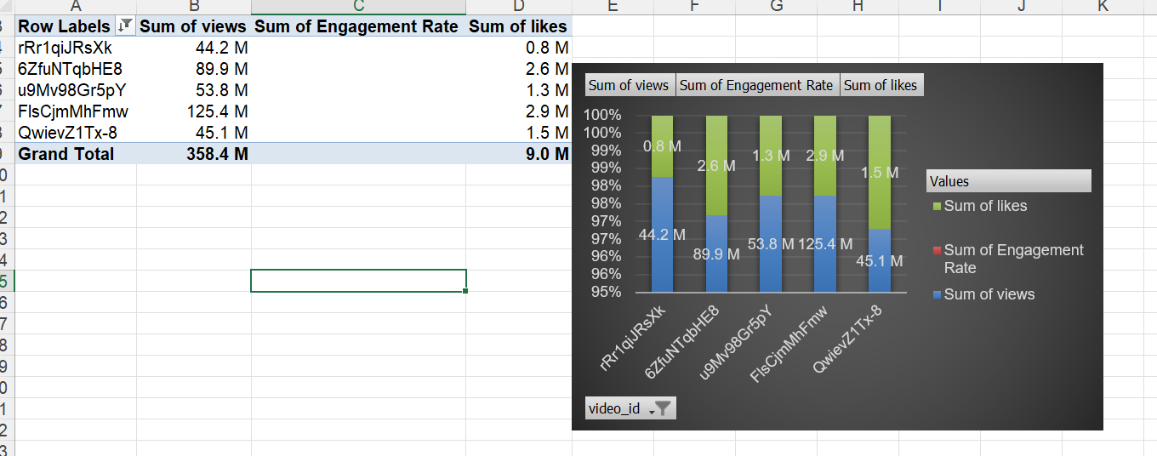
Task 8
Inference :
Steps :

Slide 10
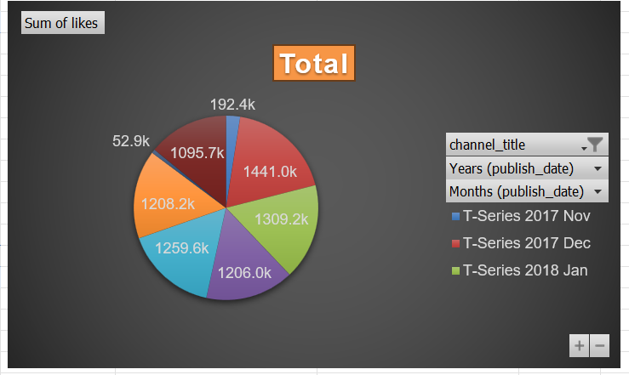
Task 9
Inference :
Steps :

Slide 11
Task 10
Inference :
Steps :

Slide 12
Task 11
Inference :
Steps :

Slide 13
Task 12
Inference :
Steps :

Slide 14
Task 13
Inference :
Steps :

Slide 15
Task 14
Inference :
Steps :

Slide 16
Task 15
Inference :
Steps :

Slide 17
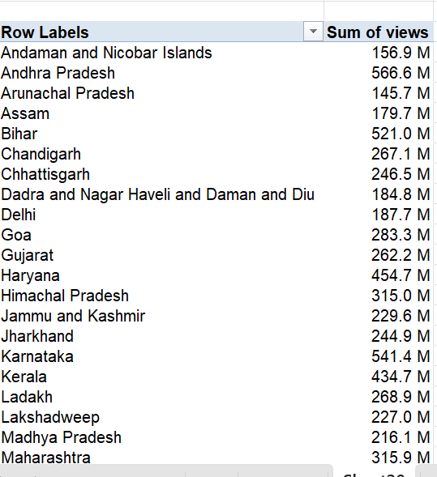
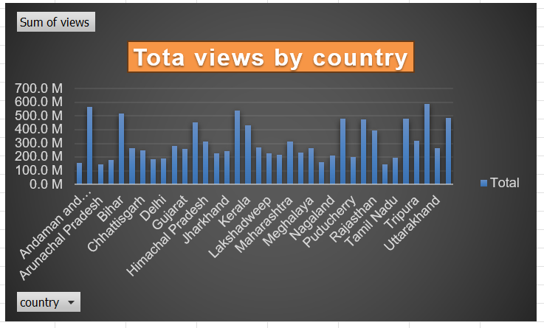
Task 16
Inference :
Tripura, Arunachal Pradesh, kerala get more views.
Bihar , TamilNadu get low views.
Steps :
Using pivot table plotted views by country and added suitable bar chart.

Slide 18
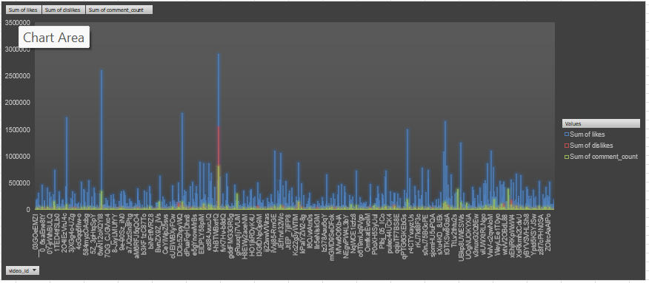
Task 17
Inference :
Steps :

Slide 19
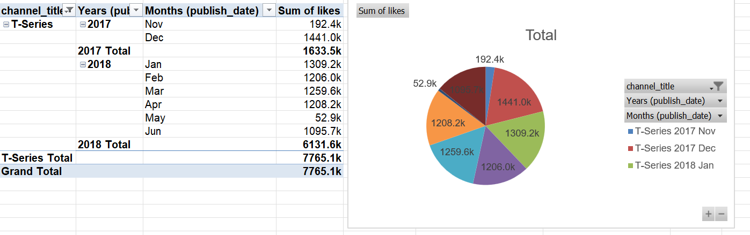
Task 18
Inference :
Steps :

Slide 20
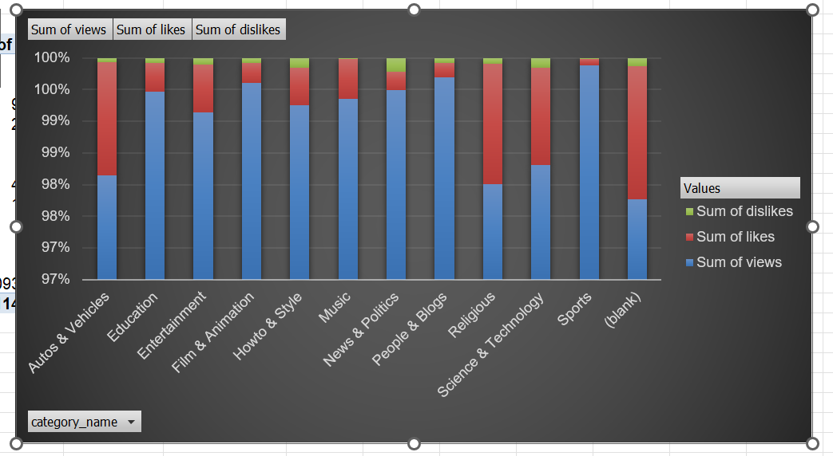
Task 19
Inference :
Steps :

Slide 21
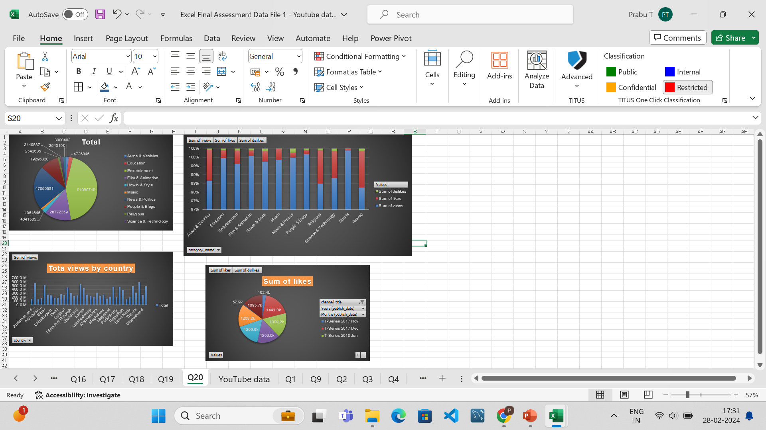
Task 20
Inference :
Steps :

Slide 22
Thank You
max growth
Name : Prabu T
Emp ID : 4295

